Slide 1


Slide 1
CSS
Train

Slide 2
Slide 2
What is CSS?
CSS is a language that describes the style of an HTML document.
CSS describes how HTML elements should be displayed.
External style sheet
Internal style sheet
Inline style
External Style Sheet
Eg:
<head> <link rel="stylesheet" type="text/css" href="mystyle.css"> </head>
Internal Style
<style>
body { background-color: lightblue; } h1 { color: navy; margin-left: 20px; }
</style>
Inline Styles
Eg:
<h1 style="color:blue;margin-left:30px;">This is a heading</h1>
Train
2

Slide 3
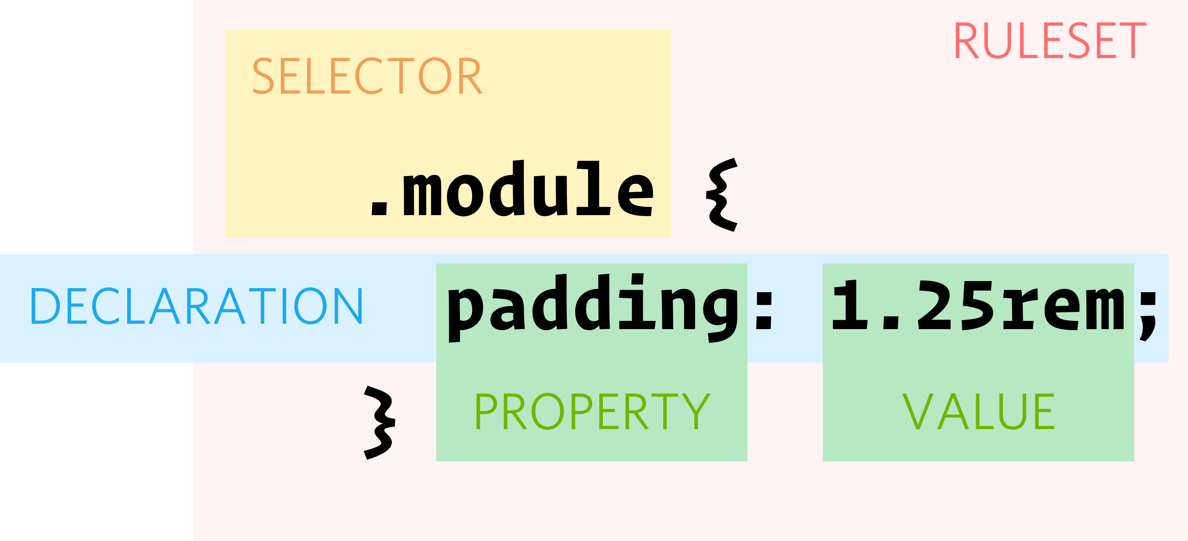
Slide 3
Anatomy of CSS
e
Train
3

Slide 4
Slide 4
CSS - Selectors
.class
#id
element
Selects all elements with the specified class
Eg:
.red{
Color:red
}
Selects the element with id
Eg:
#user{
Color:red
}
Selects all elements with the specified tag
Eg:
span{
Color:red
}
Train
4

Slide 5
Slide 12
CSS – Selectors
* - All Elements
parent child – eg: div span{}
parent > child – eg: div > span{}
sel1 + sel2 – eg: div + span{}
multi select – eg: div, span, p{}
Refer the following for a comprehensive list of selectors
https://www.w3schools.com/cssref/css_selectors.asp
Train
7

Slide 6
Slide 5
Properties - Colors
named
#HEXCODE
RGB
Eg:
Color:blue
Blue
Red
Black
White
Eg:
Color:#ff6347
Hexcode ranges from 000000 to FFFFFF
Eg:
color:rgb(255,0,12)
R – Red
G – Green
B – Blue
Range: 0 - 255
Train
5

Slide 7
Slide 12
Properties – Border and Background
Border – eg: border: 2px solid red;
style – solid, dotted, dashed, etc
Width
Color
Background
color. Eg: background-color: skyblue
image eg: background-image: url("img_tree.png")
Train
10

Slide 8
Slide 12
Properties – Margin vs Padding
Margin - The CSS margin properties are used to create space around elements, outside of any defined borders
Padding -The CSS padding properties are used to generate space around an element's content, inside of any defined borders
Top
Right
Bottom
Left
Eg - margin:10px 10px, margin:10px 8px 10px 6px, margin:5px, padding:50px 10px 0px 100px
Train
10

Slide 9
Slide 12
Properties - Text
color eg: color:blue
Text-align -> center, left, right, justify
Text-decoration -> overline, line-through, underline, none
Text-transformation -> uppercase, lowercase, capitalize
vertical-align -> baseline, text-top, text-bottom, sub, super
word-spacing
letter-spacing
direction - rtl
Train
https://www.w3schools.com/css/css_text.asp
10

Slide 10
Slide 12
Properties - font
font-family
font-style -> normal, italic, oblique
font-size
Font-weight -> bold, normal
vertical-align -> baseline, text-top, text-bottom, sub, super
word-spacing
letter-spacing
direction - rtl
Train
https://www.w3schools.com/css/css_font.asp
10

Slide 11
Slide 12
Properties – Height & Width, Inline & Block
Height eg: height:10px, height:10%
Max-height
Min-height
width eg: height:10px, height:10%
Max-width
Min-width
Display:
display:inline
display:block
Train
10

Slide 12
Slide 12
Properties – Position
Positions
static
relative
fixed
absolute
sticky
Train
https://www.w3schools.com/css/css_positioning.asp
10

Slide 13
Slide 12
Properties – Overflow, Opacity and Border-Radius
Overflow
Visbile
Hidden
Scroll
auto
border-radius
Opacity – Brings Transparency. The value ranges from 0 to 1
Eg: opacity:0.5
Train
https://www.w3schools.com/css/css_overflow.asp
10

Slide 14
Slide 12
Properties – Float
Float
Left
Right
Center
None
Train
https://www.w3schools.com/css/css_float.asp
10

Slide 15

Slide 11
Assignment Time
Train

Slide 16
Slide 12
CSS Variables
:root {
--main-bg-color: coral;
}
#div1 {
background-color: var(--main-bg-color);
padding: 5px;
}
#div2 {
background-color: var(--main-bg-color);
padding: 5px;
}
Train
https://www.w3schools.com/css/css_float.asp
10

Slide 17
Slide 12
Media Queries
body {
background-color: pink;
}
@media screen and (min-width: 480px) {
body {
background-color: lightgreen;
}
}
Train
https://www.w3schools.com/css/css_float.asp
10

